Slide 1

Ridgeway Middle IB World Optional School
Middle Years Programme
Kimberly Shaw, Principal
Katrina Raggs-Washington, Asst. Principal
Camelita Mcleod, PLC Coach
Cozbia K. Smith III, IB/Optional Schools Coordinator
Notes:
Six transdisciplinary themes

Slide 2
What’s IB?
“Global Learners, Global Scholars”
International Baccalaureate (IB) World School, you join a worldwide community of over 5,000 schools, that help create a better and more peaceful world through cultural understanding and respect.
Professional development that supports effective educators and collaborative professional learning communities.
A worldwide network of highly respected IB World Schools, working together to share best practice.
It provides a framework of academic challenge that encourages students to embrace and understand the connections between traditional subjects and the real world.
And it brings schools a strong reputation for successful outcomes that uplift the whole community.

Slide 3
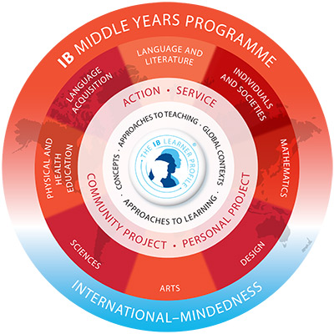
What is the Middle Years Program?
The MYP is a challenging framework that encourages students to make practical connections between their studies and the real world.
The MYP is a five-year programme, which can be implemented in a partnership between schools, or in several abbreviated (two, three or four year) formats. Students who complete the MYP are well-prepared to undertake the IB Diploma Programme (DP) or Career-related Programme (CP).
The MYP curriculum framework comprises eight subject groups, providing a broad and balanced education for early adolescents.
The MYP requires at least 50 hours of teaching time for each subject group, in each year of the programme.

Slide 4
IB Learner Profile
IB Learners Strive to Be:
  Inquirers
  Knowledgeable
  Thinkers
  Communicators
  Principled
  Open-minded
  Caring
  Risk-takers
  Balanced
  Reflective

Slide 5



What Makes Us Unique?
Ridgeway Middle is the only Middle Years Programme World School in west Tennessee.
The IB enables students to direct their own learning pathway and develop the skills and confidence they need to thrive and make a lasting difference. It empowers teachers as the architects of learning excellence, working alongside engaged colleagues in a rewarding career supported by a strong global network. And it brings schools a strong reputation for successful outcomes that uplift the whole community.
As a member of the Ridgeway feeder pattern, Ridgeway Middle School works closely with Ridgeway High School to provide a college preparatory experience in education that will prepare students for the rigorous International Baccalaureate Diploma Programme offered at Ridgeway High School.

Slide 6

Extensive Course Offerings
Enriched/Honors in English, Math, Science and Social Studies classes for qualifying Optional students
World Language (Spanish)
Options in the Arts: (Art, Band, Vocal Music, Orchestra & STEM)
High school credit classes for qualifying 8th grade students:
  (Algebra I, Physical Science, and Spanish I)
CLUE (Creative Learning in a Unique Environment) offered in 6th – 8th grades for qualifying gifted and talented students with an emphasis in Language Arts

Slide 7

Optional Requirements
Requirements:
Applicants must submit an Application for Optional Schools and copies of their most recent comprehensive report card and current nationally normed or TCAP Achievement Test scores.
Applicants must score at or above the 70th percentile on the TCAP TNReady English Language Arts and TCAP TNREADY Mathematics assessments; score at or above the 70th percentile on the Total Reading/Reading Composite and Total Mathematics/Mathematics Composite of the iReady or nationally normed achievement test. Acceptable test must be dated Spring 2020 or later.
An applicant’s report card must have A’s or B’s and no more than one C as a semester average in an academic subject. D’s or F’s are not acceptable for a grade in any semester average.
Applicant’s report card must show satisfactory conduct, work habits, and attendance (including promptness to every class). A total of more than 15 absences and/or tardies to school or to class is considered unsatisfactory.
To remain in the Optional Program, students must maintain an overall C average or above in all subjects as well as satisfactory conduct and attendance (including promptness to school and each class).
Transportation is the responsibility of the student’s parent/legal guardian.

Slide 8
For questions call
Mrs. Kimberly N. Shaw, Principal 901-416-1588
Ridgeway Middle School
Cozbia Smith 901-416-1589
IB/Optional Coordinator
Mrs. Linda Sklar, Director 901-416-5338
Optional Schools and Advanced Academics

